Slide 1


Computer Vision BS (CS) Elective
Instructor: Dr. Mohammad Asif Khan
asif.khan@iba-suk.edu.pk
Week 1

Slide 2
Unit 01 Week 01 Traditional Computer Vision

Slide 3
Contents
What is an image
Analog image
Digital image
Image as a function
Pinhole Camera
Digital Camera
Camera Intrinsics and Extrinsics
Image coordinate system

Slide 4

What is an image
An image is a visual representation of a person, object, or scene.
Can be captured by:
Cameras, Scanners, Satellites
Or created using software
Used in art, science, education, media, etc.

Slide 5
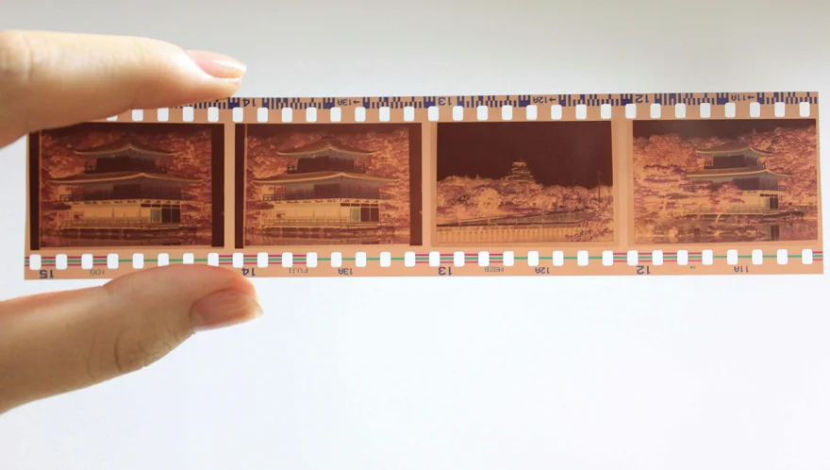

What is an analog image
Analog images are continuous representations of visual information.
Examples:
Film photography
Paintings
Printed photos
It is not made of pixels

Slide 6
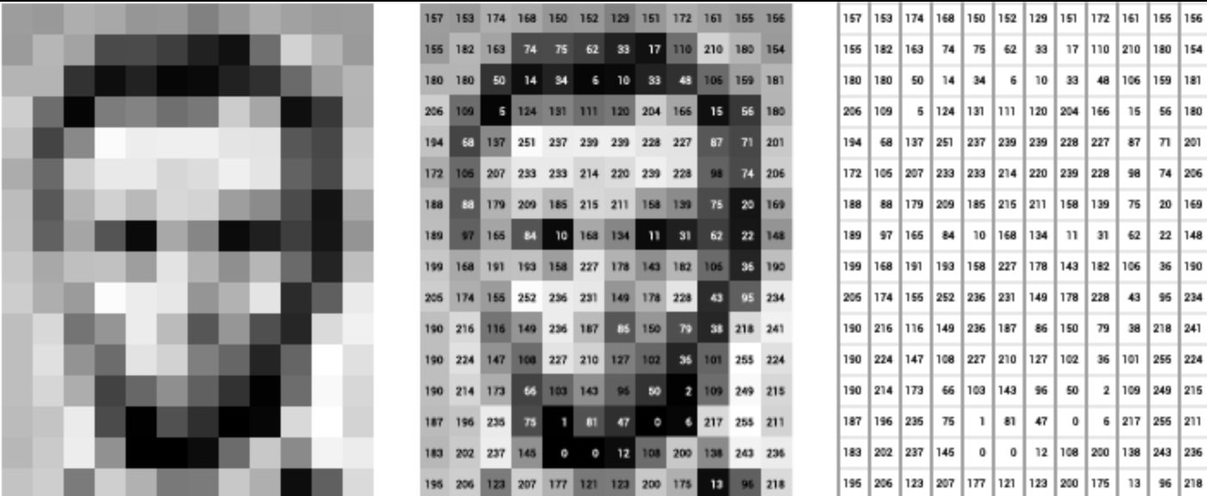
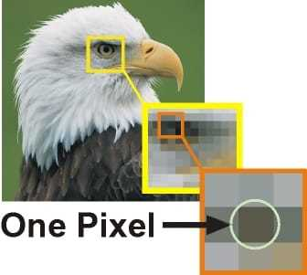
Digital image
Digital images are made of pixels (tiny color squares called picture elements)
Stored in rows and columns like a matrix
Resolution = number of pixels (e.g. 1920x1080)

Slide 7
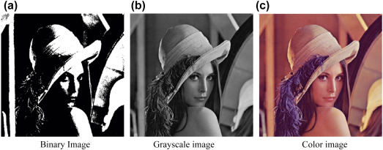
Types of images
Following are the main types of images:
Binary – only black and white
Grayscale – shades from black to white
Color (RGB) – pixels have Red, Green, Blue values

Slide 8
Types of images
Can guess the name of this women in the picture and her current age?

Slide 9

Types of images
Current Lena

Slide 10
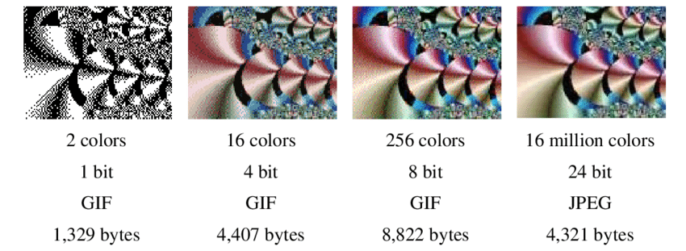
Image dimension and size
Dimensions = width × height in pixels
Bit Depth = how many bits per pixel (affects color range)
File size depends on resolution + format (JPEG, PNG)

Slide 11

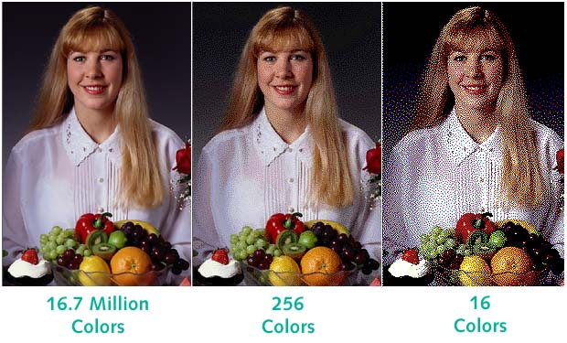
Image dimension and size

Slide 12
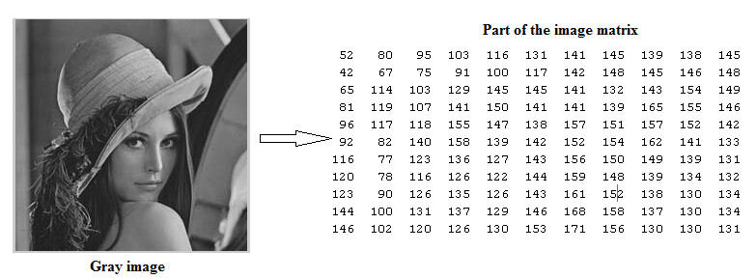
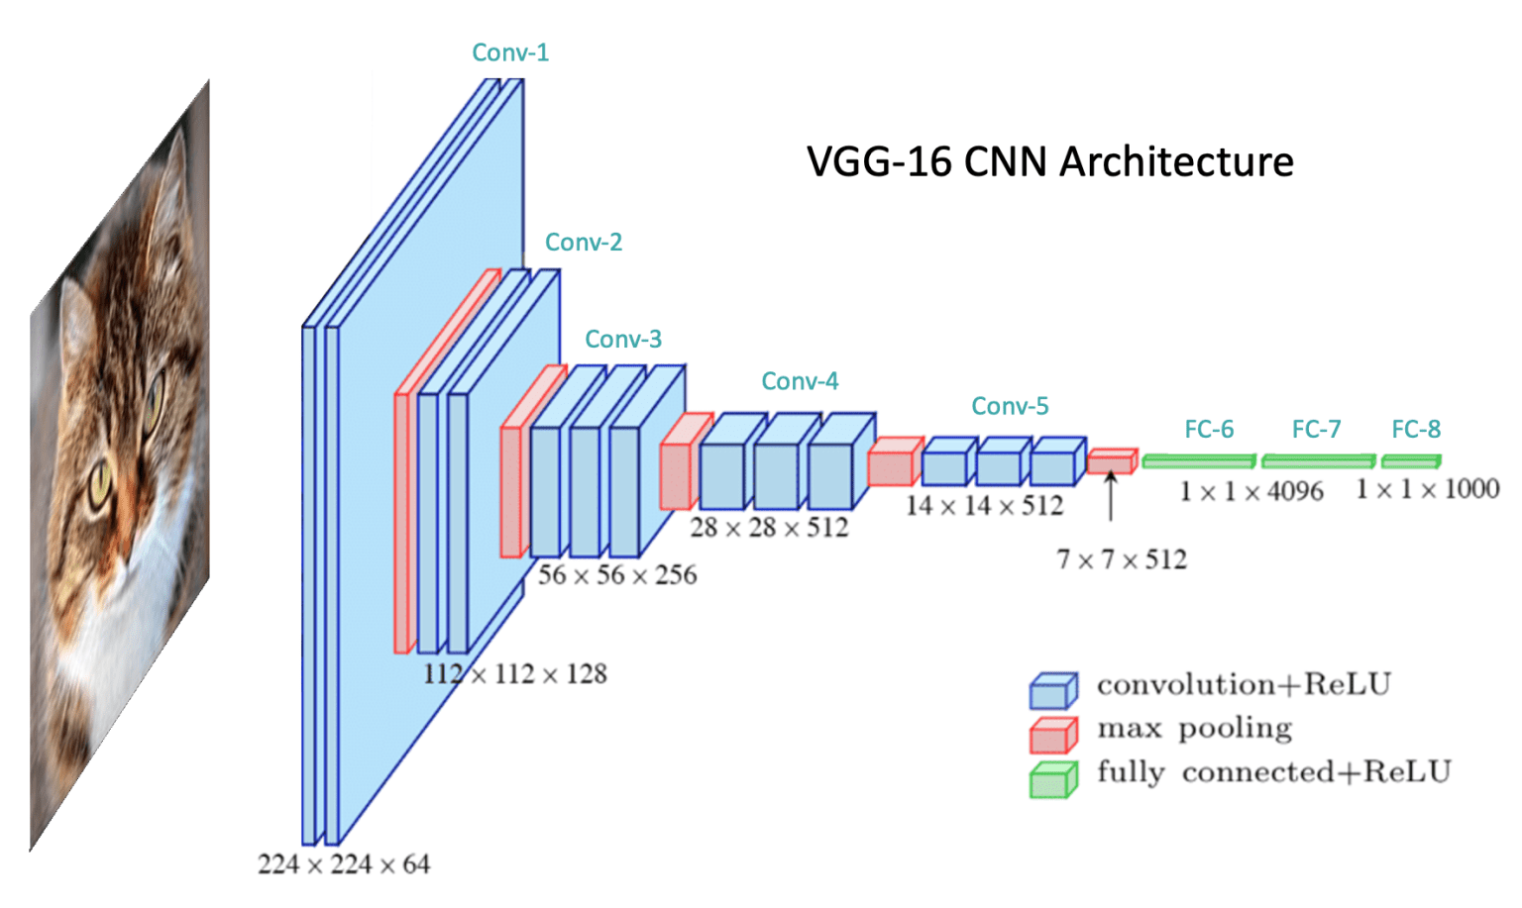
How computer see images
Images are stored as matrices
Grayscale: 2D array
RGB: 3D array (W × H × 3)
Used in:
AI (e.g., CNNs)
Image editing tools

Slide 13
Image as a function
An image is a mathematical function:
f(x, y) for grayscale (2D)
f(x, y, c) for color (3D), where c = channel (R, G, B)
The color image no longer has a single intensity value, instead it is a vector, that holds three different intensity values e.g., R, G and B.
Therefore, if image is a function, then we can do what we can do with a function e.g., adding two image, subtracting them etc.

Slide 14

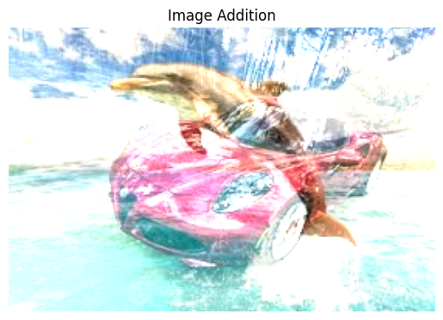

Image as a function
Adding two images

Slide 15
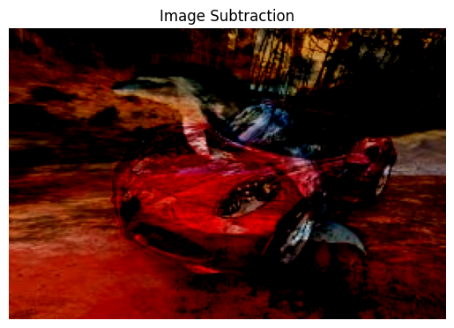
Image as a function
Subtracting two images
Dolphin – car
Subtracting one image from another highlights differences between them.
Often used in motion detection or change analysis.

Slide 16
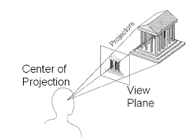
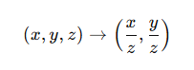

Perspective Projection of an image
How Cameras See the 3D World in 2D
A geometric transformation from 3D to 2D
Models how cameras or human eyes perceive depth
Objects farther away appear smaller
Uses a pinhole camera model
Formula:

Slide 17
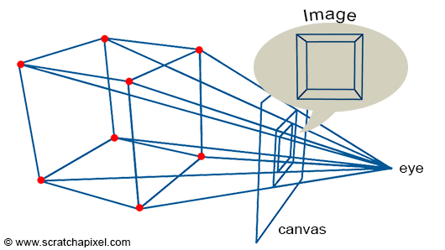
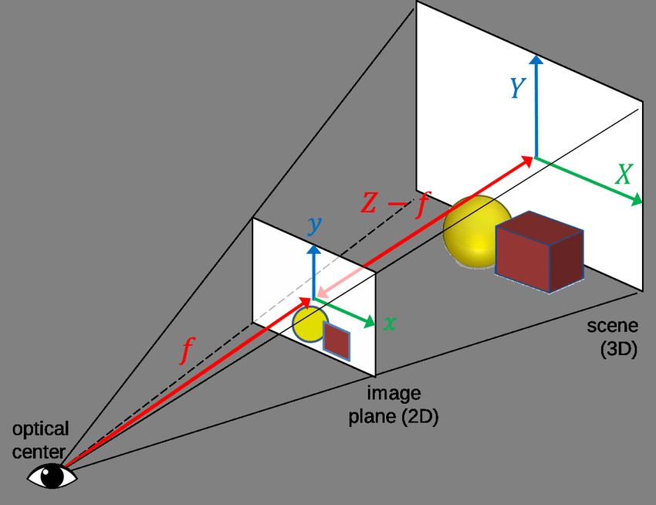
Perspective Projection of an image
Derived from Renaissance art techniques
Goal: Depict realistic depth on flat surfaces
“Perspective” means seeing through from Latin perspicere
Perspective projection is a method in computer vision that simulates how the human eye or a camera perceives the world in three dimensions and projects it onto a two-dimensional surface (like a screen or photo).
It is a type of projection where 3D points are mapped onto a 2D plane (like an image sensor or screen) using lines that all converge at a single point called the camera center (or focal point).
Notes:
Renaissance art refers to the art produced in Europe during the Renaissance period (roughly 14th to 17th century), a time of cultural rebirth following the Middle Ages. It marked a major shift in the way artists viewed the world, humans, and nature.
Key Characteristics of Renaissance Art
Realism and Naturalism Artists aimed to depict the human body, nature, and everyday life more realistically than before.
Humanism Focus on human beings, their emotions, achievements, and individual potential, inspired by the study of classical Greek and Roman culture.
Perspective The development of linear perspective created the illusion of depth and three-dimensional space on a flat surface.
Anatomical Accuracy Artists studied human anatomy to portray the body more accurately and proportionally.
Use of Light and Shadow Techniques like chiaroscuro were used to create depth and volume through contrast between light and dark.
Classical Influence Renaissance art was heavily inspired by ancient Greek and Roman art, architecture, and philosophy.

Slide 18
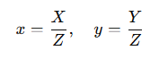
Perspective Projection of an image
Given a 3D point in camera coordinates (𝑋,𝑌,𝑍):
Z: Depth
Resulting in normalized 2D coordinates
Key Point: Depth 𝑍 controls apparent size of the object

Slide 19
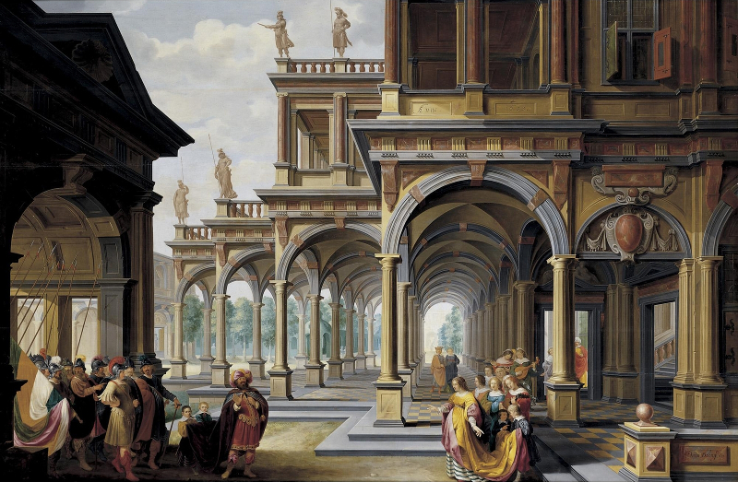

Perspective Projection of an image
Renaissance art samples
You may notice the depiction of depth (3D) onto 2D images/surfaces/planes.
Notes:
Renaissance art refers to the art produced in Europe during the Renaissance period (roughly 14th to 17th century), a time of cultural rebirth following the Middle Ages. It marked a major shift in the way artists viewed the world, humans, and nature.
Key Characteristics of Renaissance Art
Realism and Naturalism Artists aimed to depict the human body, nature, and everyday life more realistically than before.
Humanism Focus on human beings, their emotions, achievements, and individual potential, inspired by the study of classical Greek and Roman culture.
Perspective The development of linear perspective created the illusion of depth and three-dimensional space on a flat surface.
Anatomical Accuracy Artists studied human anatomy to portray the body more accurately and proportionally.
Use of Light and Shadow Techniques like chiaroscuro were used to create depth and volume through contrast between light and dark.
Classical Influence Renaissance art was heavily inspired by ancient Greek and Roman art, architecture, and philosophy.

Slide 20

Component of Perspective Projection
Railway track

Slide 21
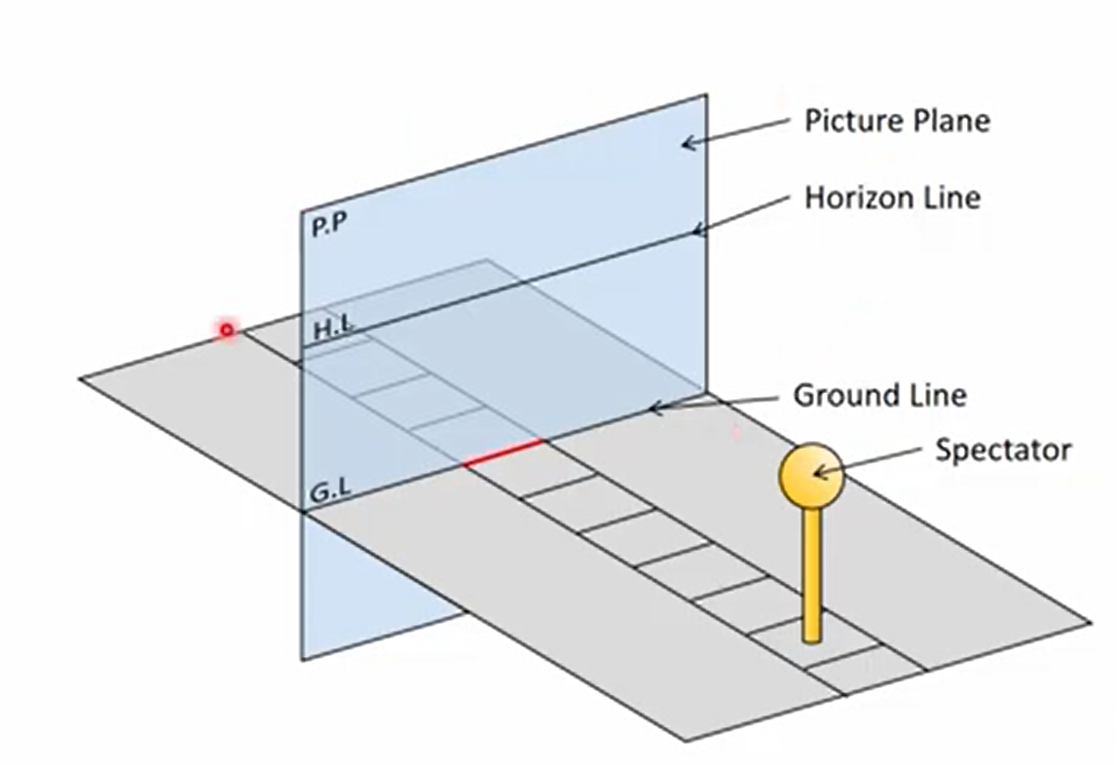
Component of Perspective Projection
Railway track

Slide 22
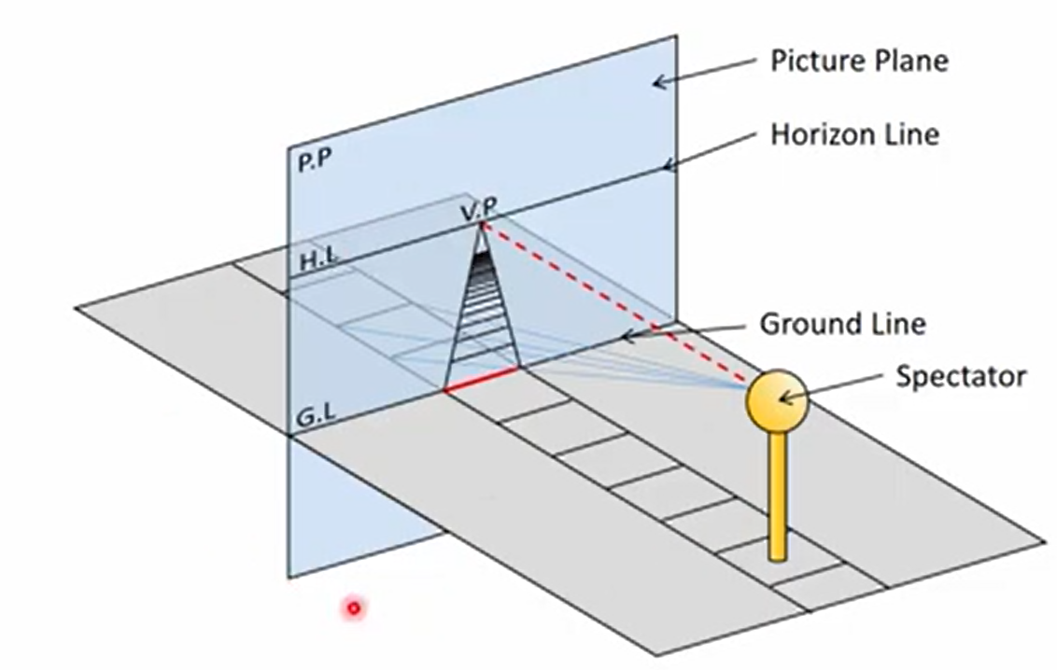
Component of Perspective Projection

Slide 23
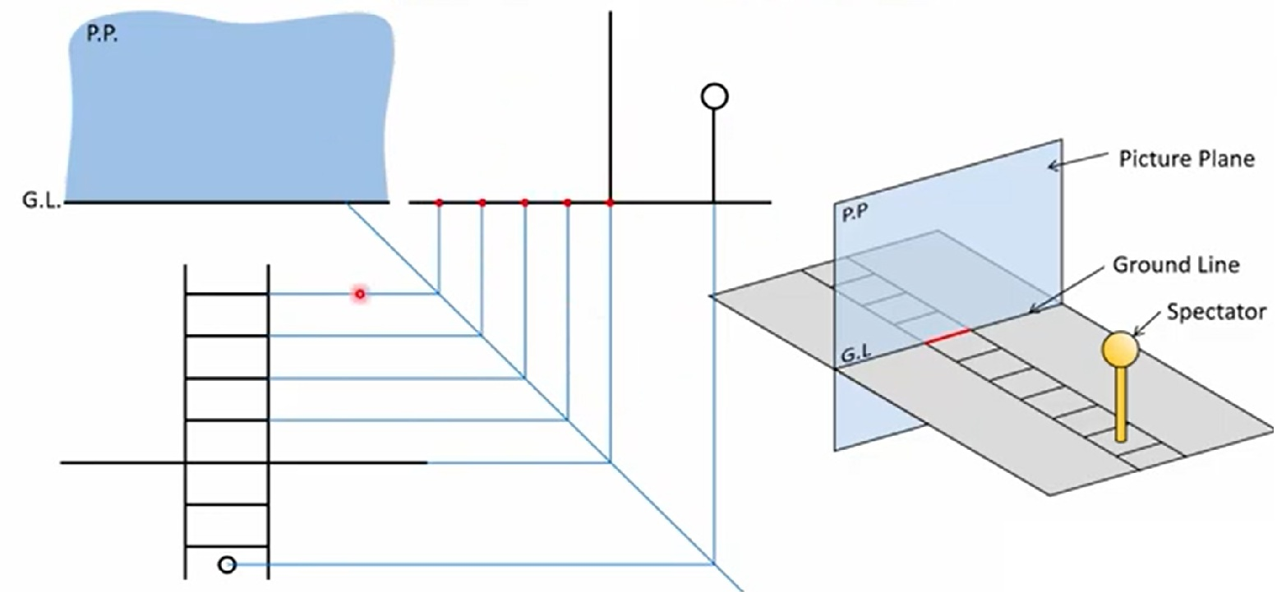
Component of Perspective Projection

Slide 24
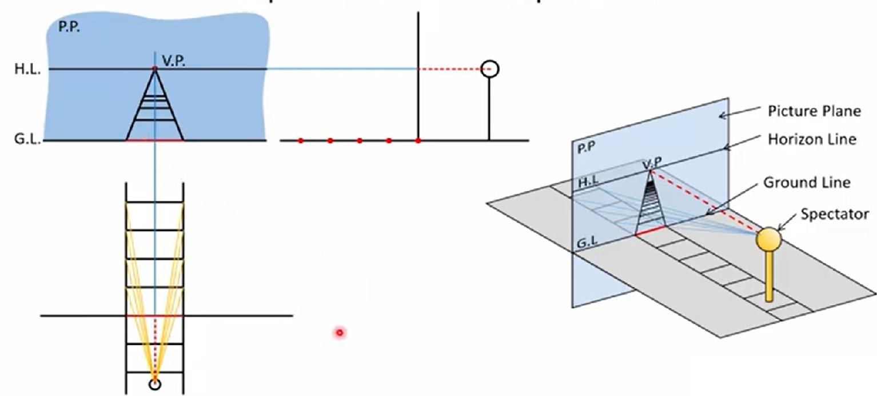
Component of Perspective Projection
Class task: To better understand the concept of 3D project on 2D picture plane, please redraw
the taught concept on your notebook!

Slide 25
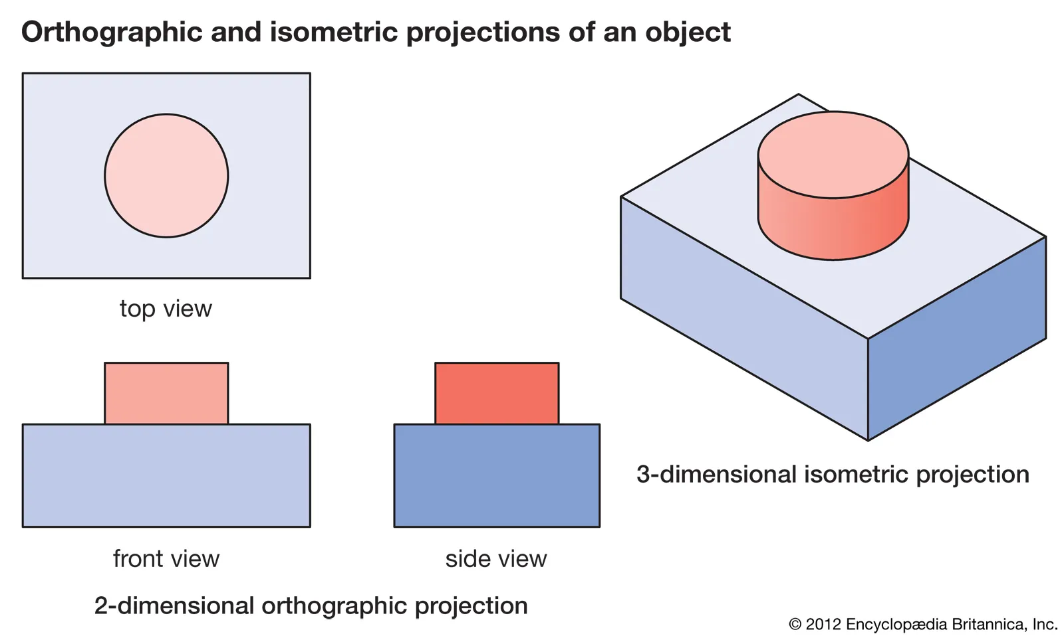
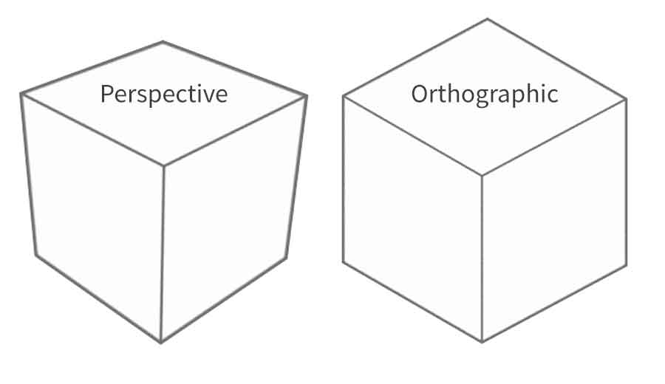
Orthographic Projections of objects
A type of projection where 3D objects projected onto a 2D plane using parallel lines
No perspective distortion — size remains the same regardless of depth
Used to represent accurate dimensions (𝑥,𝑦,𝑧)→(𝑥,𝑦)
Everyone must provide an example to show understanding of orthographic projection.

Slide 26
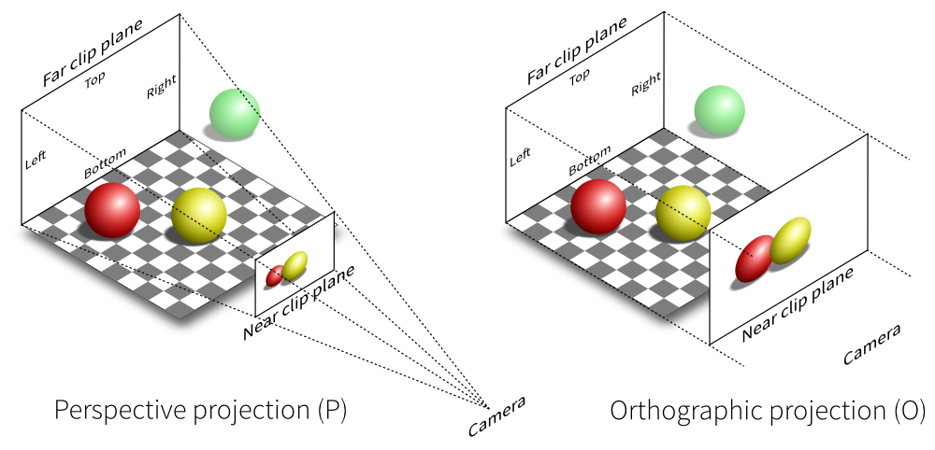
Orthographic Projections of objects

Slide 27
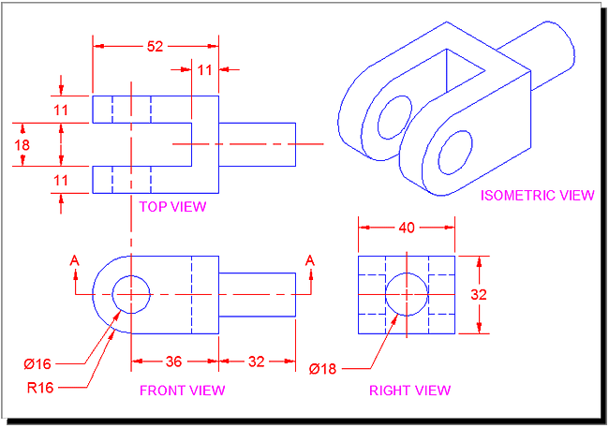
Orthographic Projections of objects

Slide 28
Orthographic Projections of objects
Feature | Orthographic Projection | Perspective Projection
Projection rays | Parallel | Converge at a point (CoP)
Appearance of depth | Flat, uniform size | Farther objects appear smaller
Scale preservation | Yes | No
Realism | Low | High
Use case | Engineering, CAD | Photography, computer graphics

Slide 29
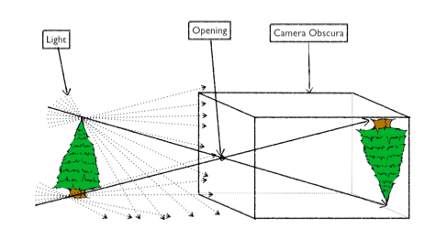
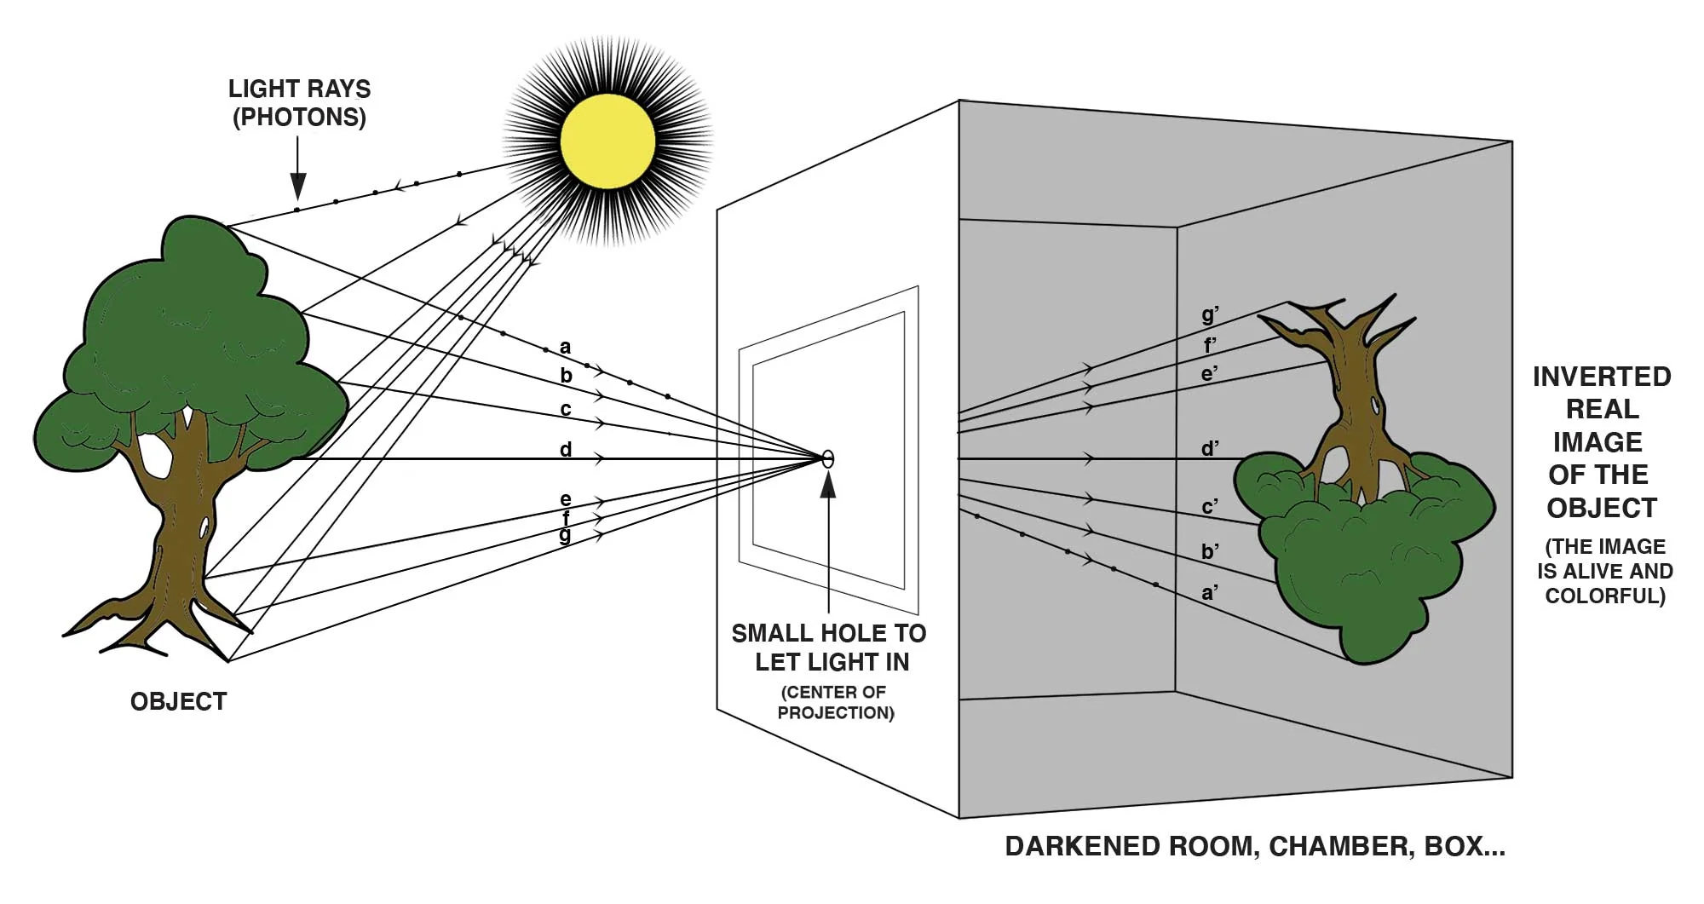
Pinhole Camera
A pinhole camera is a simple device that forms an image without a lens.
It uses a tiny hole (aperture) to project an inverted image onto a surface inside a dark box or container.
Also known as a "camera obscura (dark chamber)"

Slide 30
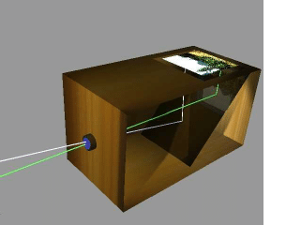
Pinhole Camera

Slide 31
Pinhole Camera (How it works)
Light travels in straight lines.
The small hole allows light from the scene to enter and project an inverted image.
The smaller the hole, the sharper the image—but dimmer.

Slide 32

Pinhole Camera (How it works)
The smaller the hole, the sharper the image—but dimmer.

Slide 33
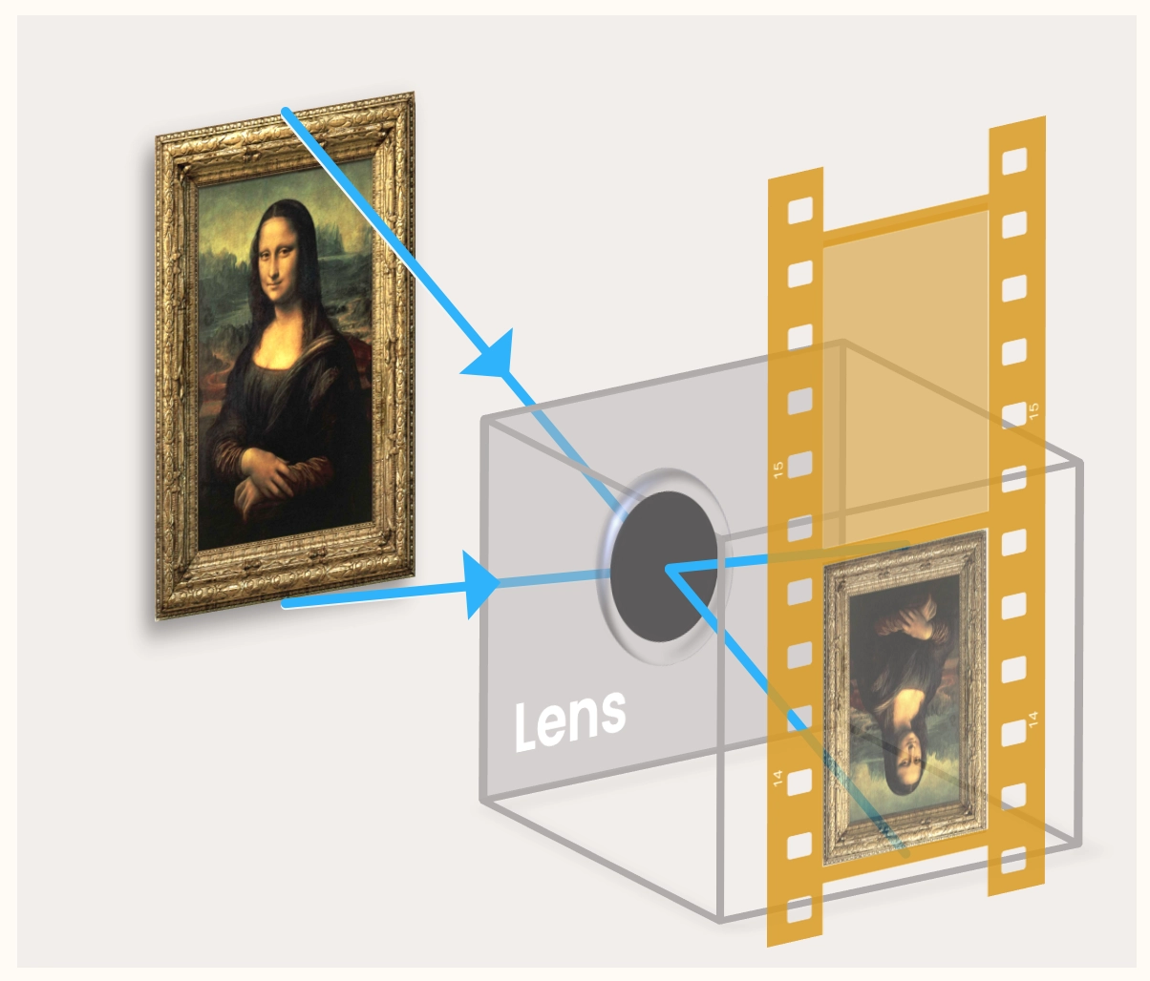
Analogue Camera
Analogue and digital cameras have much larger holes (apertures) than pinhole cameras.
To stop the image becoming blurry, a lens is used to focus the light.
A pinhole camera isn't enough, is it? You can't exactly take your holiday pics with it, as there's no way to keep the images!
We need to put something on the back wall that keeps the image. For this, we use film.
Ref:https://www.physicsfox.org/waves/camera/

Slide 34

Analogue Camera
We need to put something on the back wall that keeps the image. For this, we use film.
Film is a thin strip of plastic with a special chemical layer on top.
This chemical layer reacts with light; the more light hitting some area of it, the darker this area gets.
(NB: This means that bright objects look dark on film, and dark objects look bright. This is why the images on film are called 'negatives' ).

Slide 35
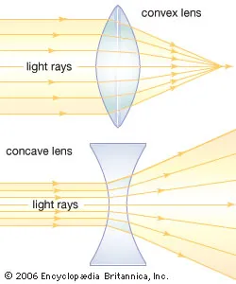
Analogue Camera
To stop the light from spreading out, we put a (convex) lens just behind the hole.
Lenses focus light, making the large hole act as if it's a pinhole.
This makes the image a lot sharper.
Lenses give us the way to let more light in is to create a burst of light when you take the picture.
This is why cameras have a flash!

Slide 36
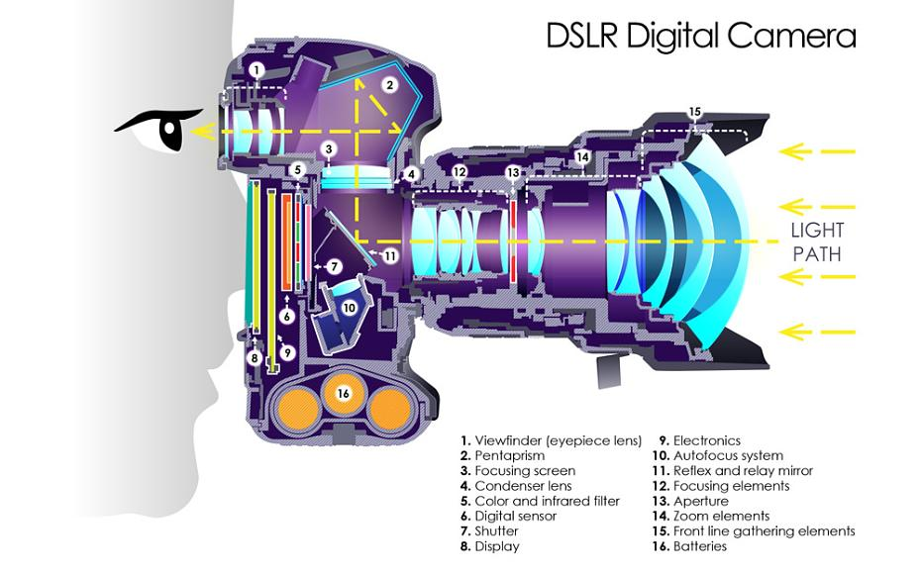
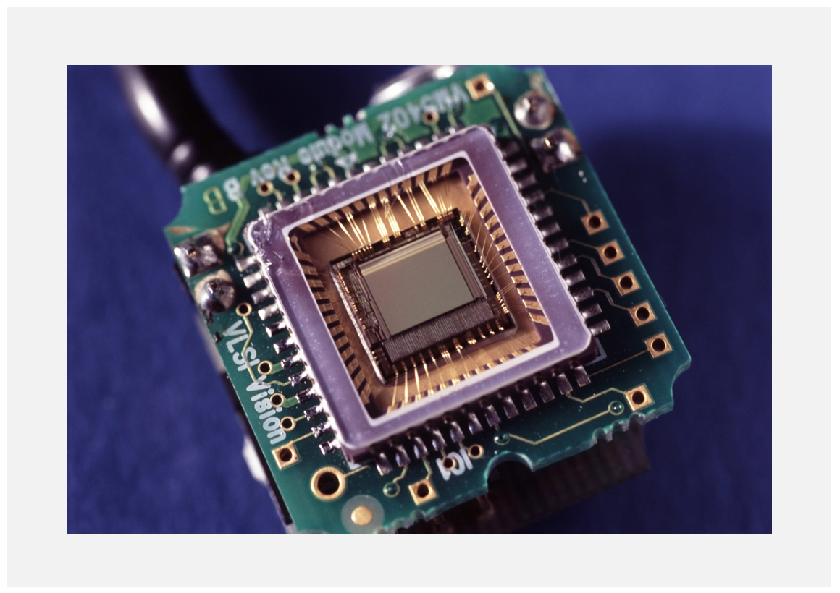
Digital Camera
Digital cameras (like those found in phones) basically work in the same way as analogue cameras, except instead of film you have an image sensor.
Image sensors are electrical chips with millions of tiny squares called pixels.
Each pixel can detect how much light has hit it, so the more pixels you have the better the image resolution is. (A million pixels is called a megapixel)

Slide 37
Camera Intrinsics and Extrinsics
Recovering 3D structure of a scene from its image (2D)
For reconstruction of 3D scene, you need to know where each point lies in the real world coordinate frame in mm level. However, to do this your have only an image, were each point lies in pixels.
To do this reconstruction your need the position and orientation of camera w.r.t to world coordinate frame and this is called camera extrinsics.
How the camera is mapping 3D world coordinates to its image plane are called intrinsics.
Determining extrinsic and intrinsics is called camera calibration.

Slide 38
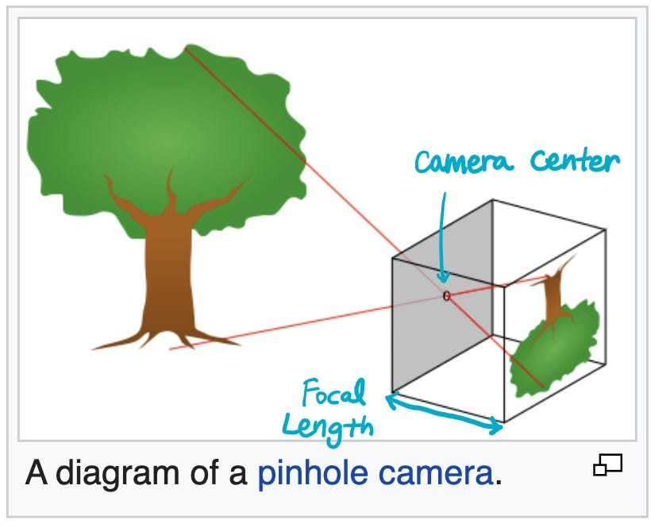
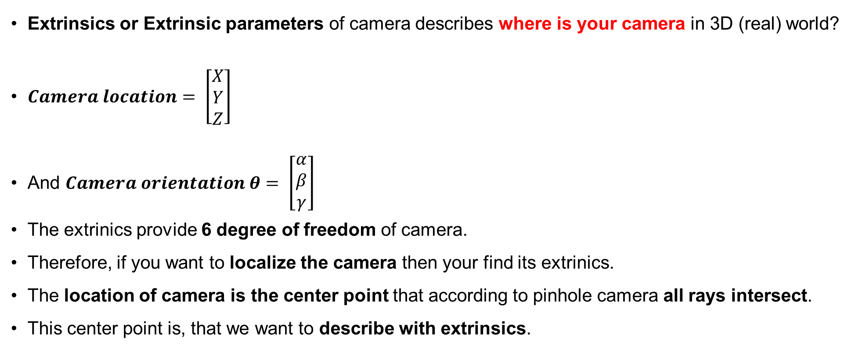
Camera Intrinsics and Extrinsics
Extrinsics or Extrinsic parameters of camera describes where is your camera in 3D (real) world?
$Camera location= \left[\begin{aligned}X \\ Y \\ Z\end{aligned}\right]$
And $Camera orientation θ= \left[\begin{aligned}α \\ β \\ γ\end{aligned}\right]$
The extrinics provide 6 degree of freedom of camera.
Therefore, if you want to localize the camera then your find its extrinics.
The location of camera is the center point that according to pinhole camera all rays intersect.
This center point is, that we want to describe with extrinsics.
The question from class is, what is locations and orientation?

Slide 39
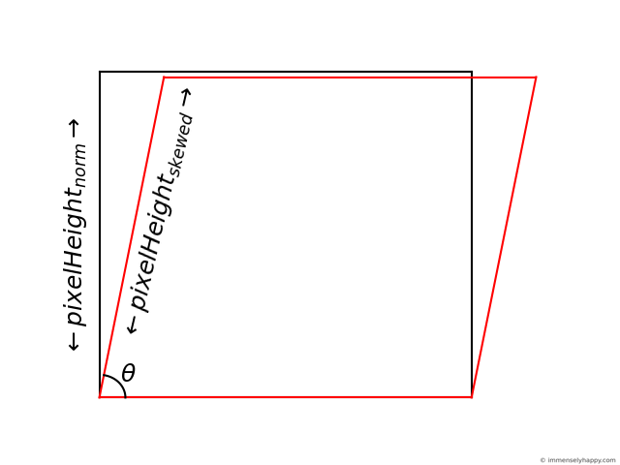
Camera Intrinsics and Extrinsics
Intrinsics or Intrinsic parameters sits inside the camera.
It helps is describe how a 3D point in real world is mapped to a 2D image.
We find intrinsics with assumption that the camera sits at its origin with zero orientation.
There are 5 intrinsic parameters:
A camera constant C the distance between camera’s image plane and the projection center.
Camera Constant C (or 𝑓), also called the focal length. Defined as the distance between the center of projection (CoP) and the image plane. Measured in mm (physically) or pixels (in image coordinates).
M is x-y scale difference
The focal length in x-y direction fx and fy
Two parameters of principle point, principle point is location on image sensor/pixels where the principle axis passes.
If you have analogue camera then you would need shear parameter s. In digital cameras it is almost zero.
What do I mean by zero origin and zero orientation?
Notes:
Why we use fx and fy instead of only f?
1. Pixel size might differ along x and y
Cameras use a digital image sensor (e.g., CCD or CMOS).
The physical size of each pixel (called the pixel pitch) may not be the same in horizontal and vertical directions.
So, even if focal length in mm is the same in both directions, the focal length in pixel units becomes different:
fx=f⋅1/sx ,fy=f⋅1/sy​ where:
f: actual focal length (in mm)
sx,sy : pixel size in mm/pixel in x and y direction
As we measure focal length in pixels (not in mm), it can be different along the x and y axes due to differences in pixel size or scaling. Even if the physical focal length is the same, the number of pixels per millimeter might differ in the horizontal and vertical directions, leading to different values for fx and fy.

Slide 40
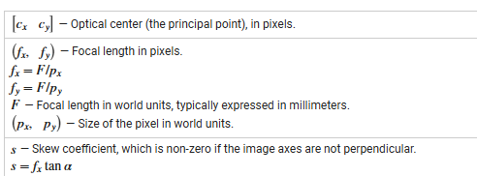
Camera Intrinsics and Extrinsics
Intrinsics or Intrinsic parameters

Slide 41
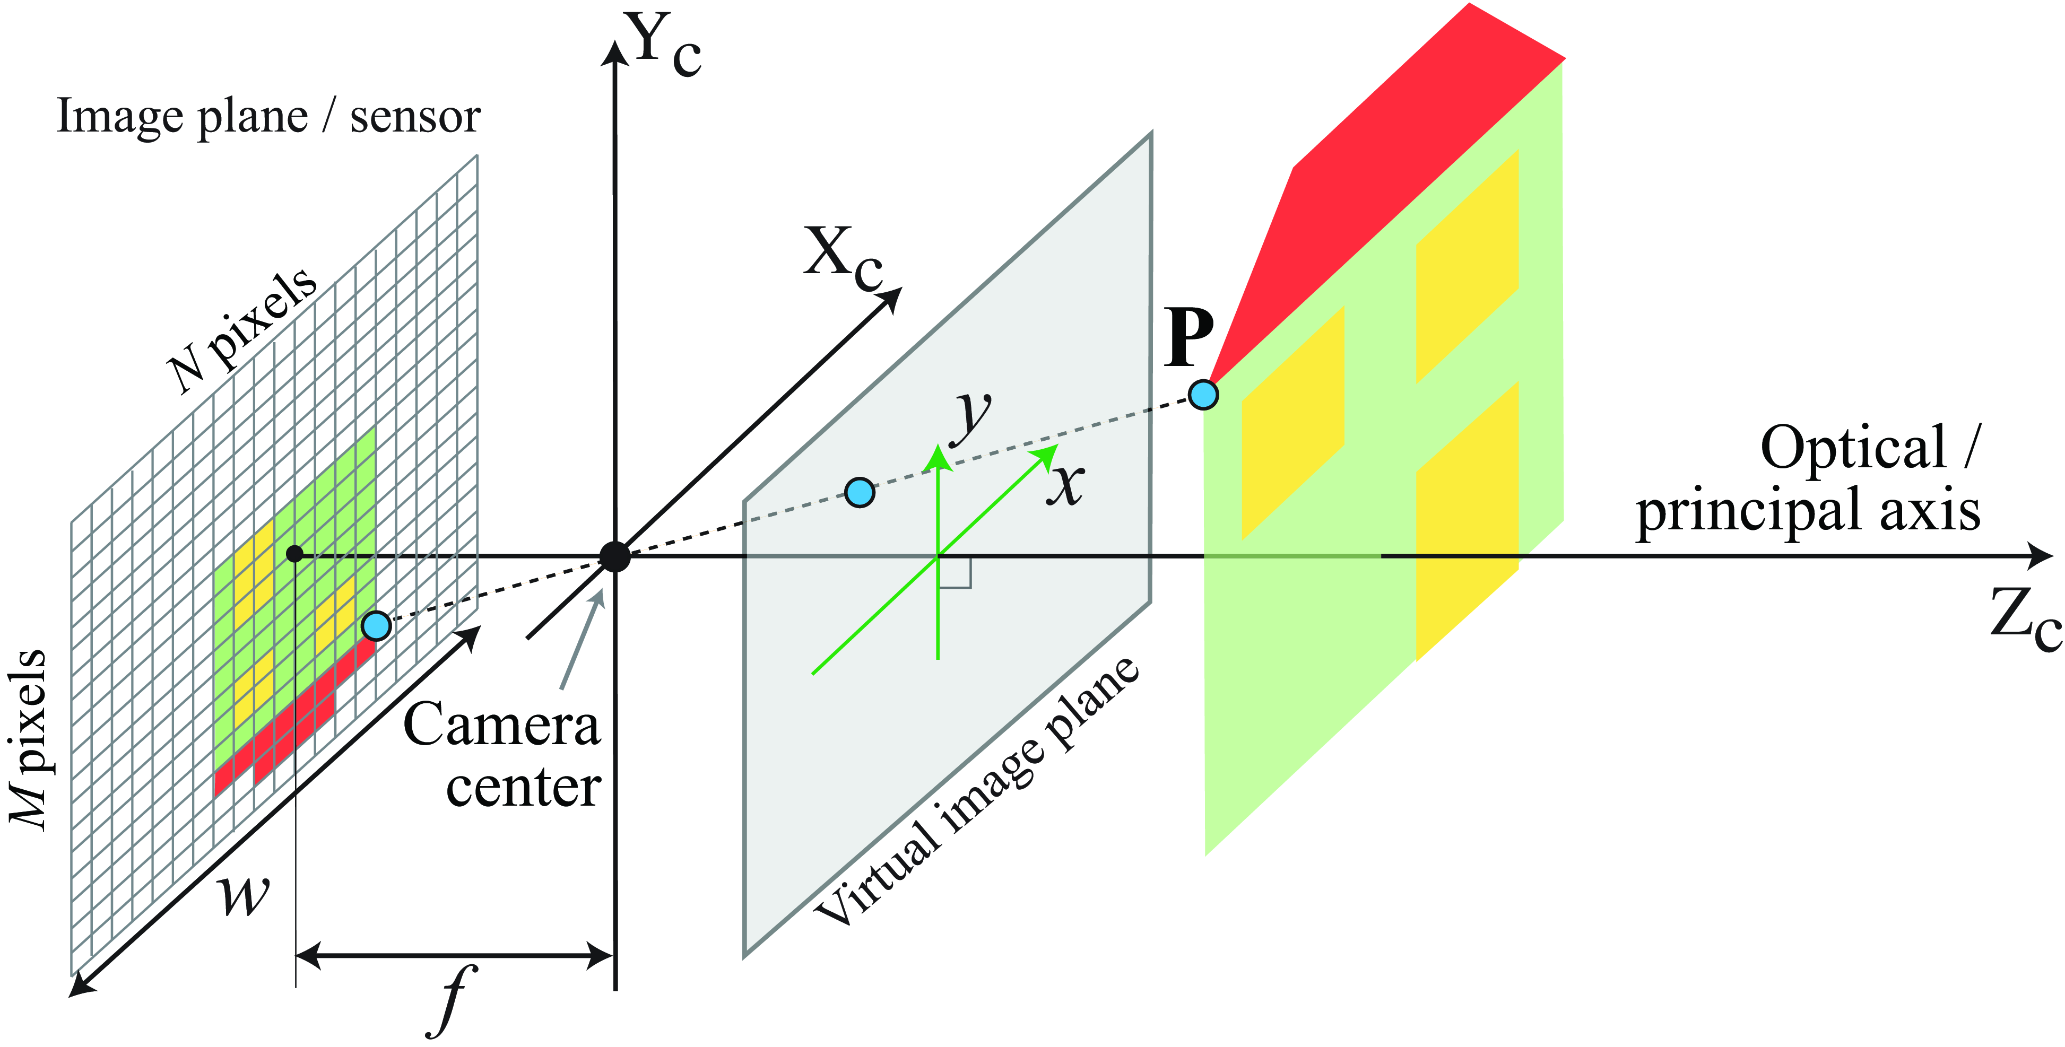
Camera Intrinsics and Extrinsics

Slide 42

Converting 3D World Coordinates into 2D Image Coordinates
Converting 3D world coordinates to 2D image coordinates involves following coordinate systems:
World Coordinate System – describes 3D positions in the real world
Camera Coordinate System – origin at camera center (CoP)
Image Coordinate System – 2D plane before pixel conversion
Pixel Coordinate System – final image in pixels

Slide 43
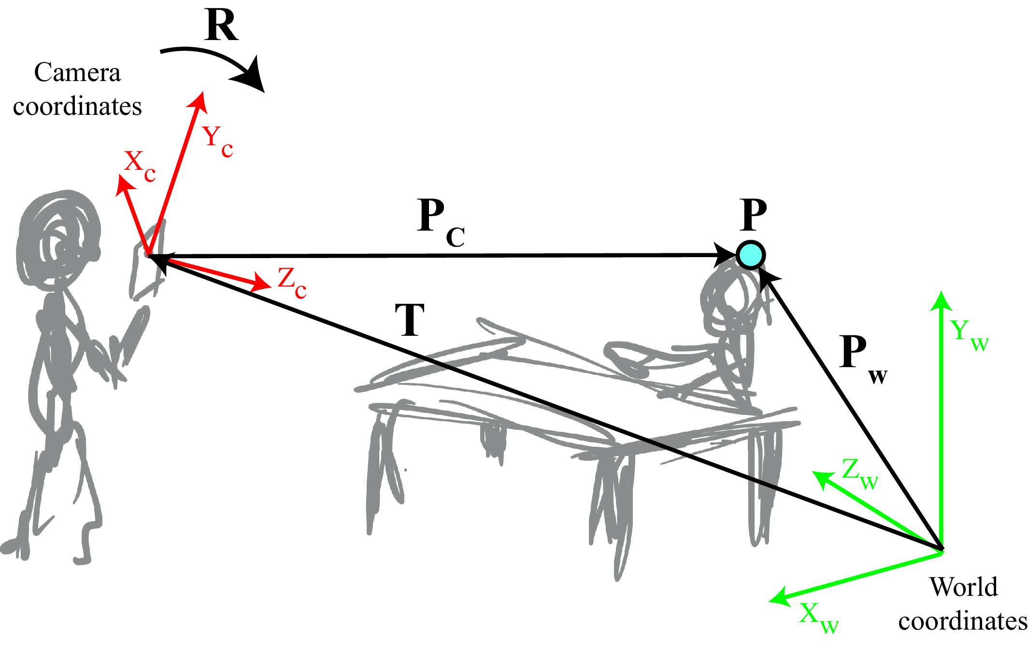
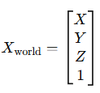
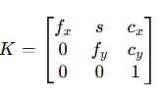
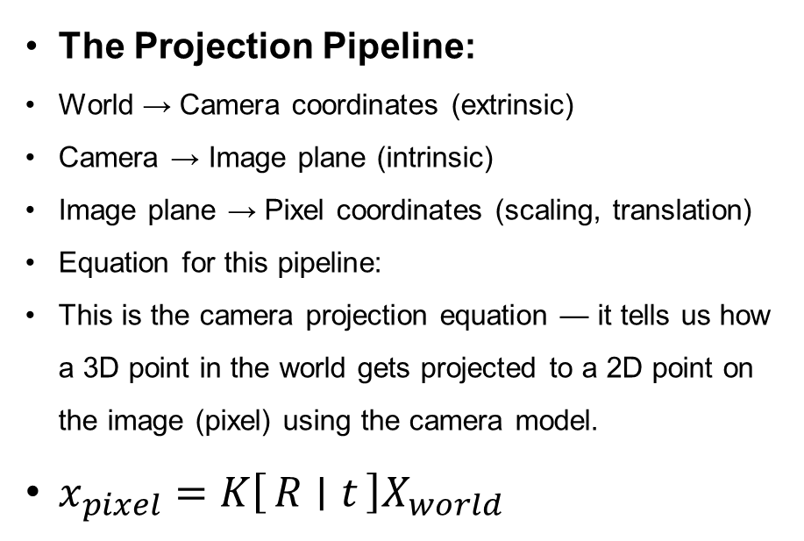
Converting 3D World Coordinates into 2D Image Coordinates
The Projection Pipeline:
World → Camera coordinates (extrinsic)
Camera → Image plane (intrinsic)
Image plane → Pixel coordinates (scaling, translation)
Equation for this pipeline:
This is the camera projection equation — it tells us how a 3D point in the world gets projected to a 2D point on the image (pixel) using the camera model.
$x_{pixel}​=K\left[R ∣ t\right]X_{world​}$
What is K, R and T?

Slide 44
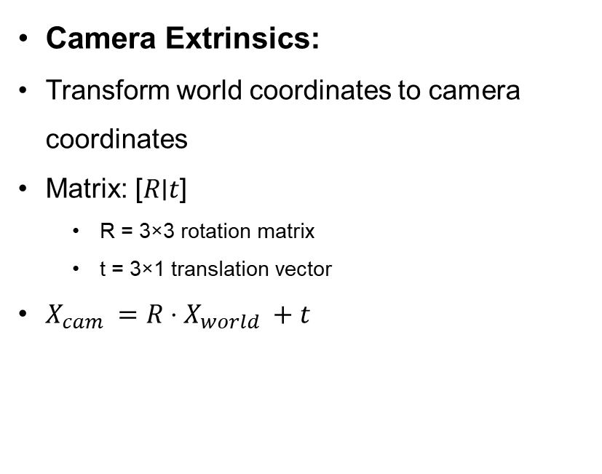
Converting 3D World Coordinates into 2D Image Coordinates
Camera Extrinsics:
Transform world coordinates to camera coordinates
Matrix: [𝑅∣𝑡]
R = 3×3 rotation matrix
t = 3×1 translation vector
$X_{cam}​ =R⋅X_{world}​ +t$

Slide 45
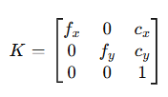
Converting 3D World Coordinates into 2D Image Coordinates
Camera Intrinsics:
Maps 3D camera coordinates to 2D image coordinates
K (Intrinsic Matrix):
𝑓𝑥,𝑓𝑦​ : focal lengths
𝑐𝑥,𝑐𝑦​ : optical center (usually center of image)

Slide 46
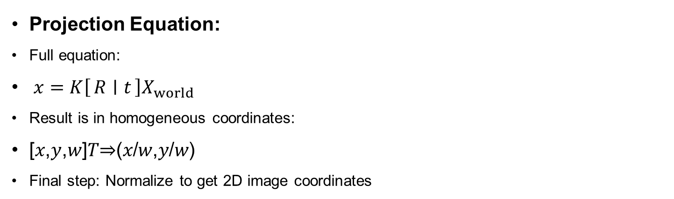
Converting 3D World Coordinates into 2D Image Coordinates
Projection Equation:
Full equation:
$x=K\left[R ∣ t\right]X_{world} ​$
Result is in homogeneous coordinates:
[𝑥,𝑦,𝑤]𝑇⇒(𝑥/𝑤,𝑦/𝑤)
Final step: Normalize to get 2D image coordinates

Slide 47
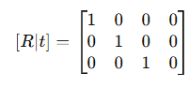
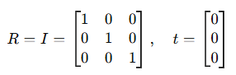
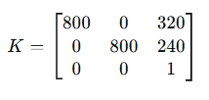
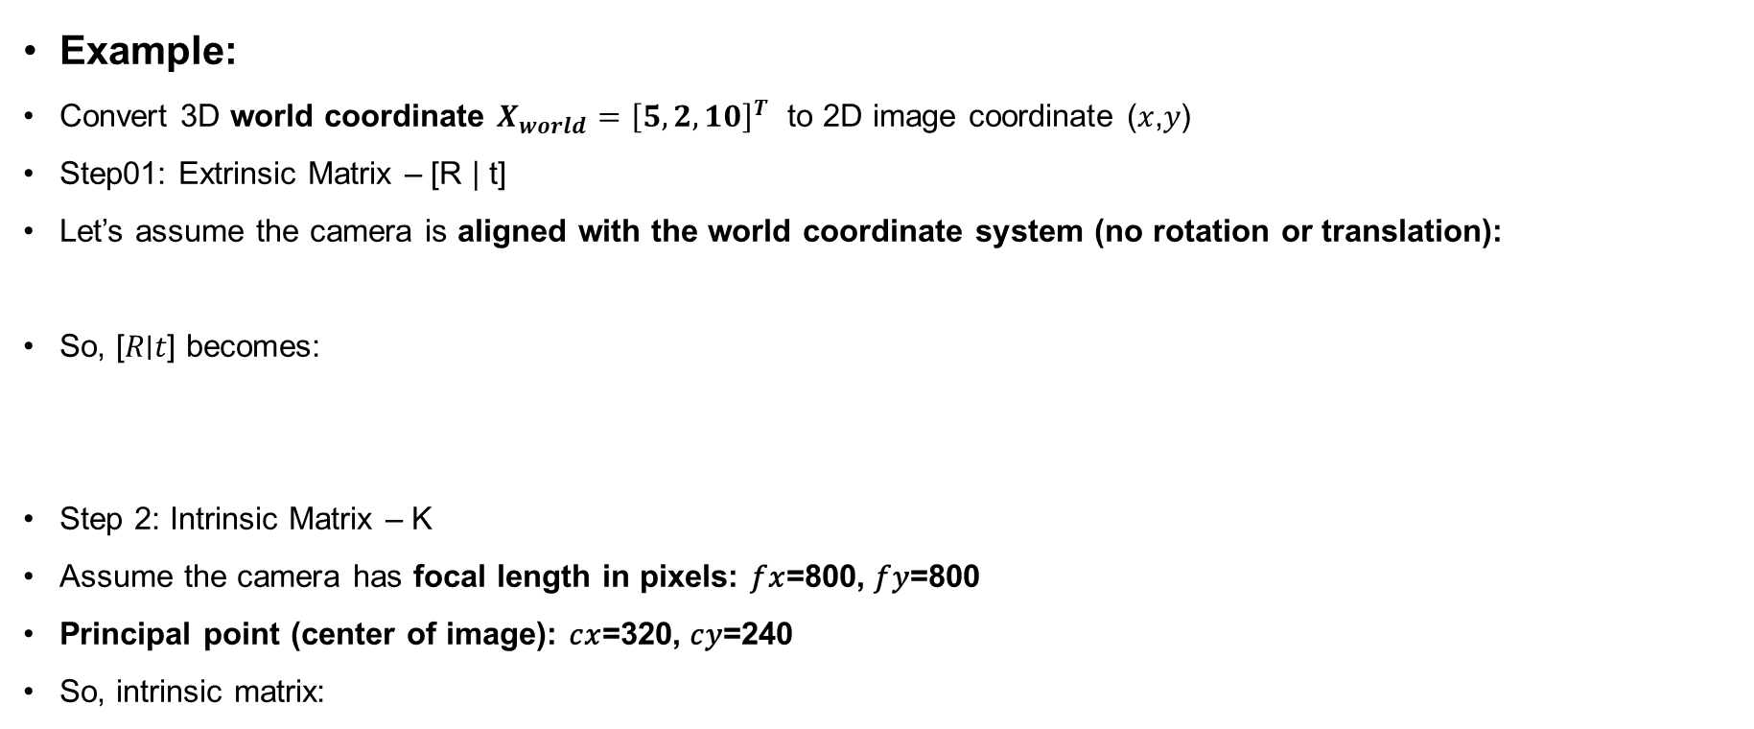
Converting 3D World Coordinates into 2D Image Coordinates
Example:
Convert 3D world coordinate $X_{world}={\left[5,2,10\right]}^{T}$ to 2D image coordinate (𝑥,𝑦)
Step01: Extrinsic Matrix – [R | t]
Let’s assume the camera is aligned with the world coordinate system (no rotation or translation):
So, [𝑅∣𝑡] becomes:
Step 2: Intrinsic Matrix – K
Assume the camera has focal length in pixels: 𝑓𝑥=800, 𝑓𝑦=800
Principal point (center of image): 𝑐𝑥=320, 𝑐𝑦=240
So, intrinsic matrix:

Slide 48
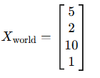
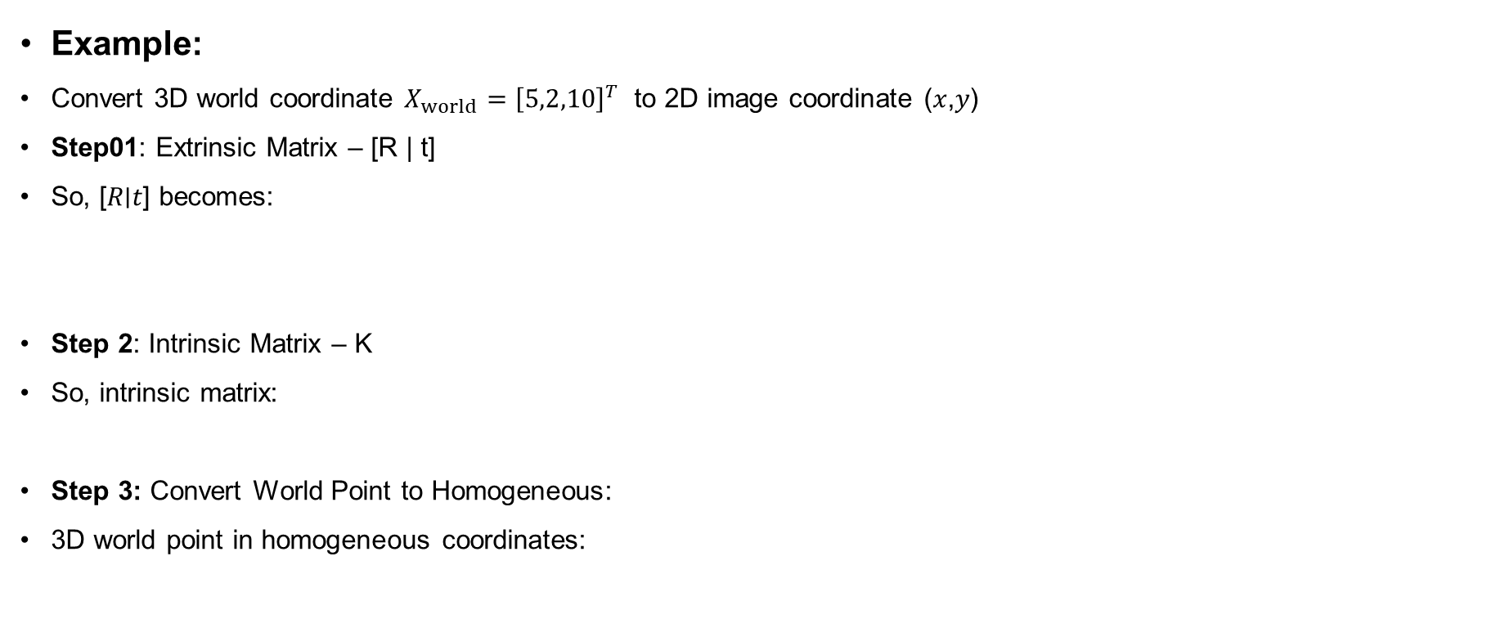
Converting 3D World Coordinates into 2D Image Coordinates
Example:
Convert 3D world coordinate $X_{world}={\left[5,2,10\right]}^{T}$ to 2D image coordinate (𝑥,𝑦)
Step01: Extrinsic Matrix – [R | t]
So, [𝑅∣𝑡] becomes:
Step 2: Intrinsic Matrix – K
So, intrinsic matrix:
Step 3: Convert World Point to Homogeneous:
3D world point in homogeneous coordinates:

Slide 49
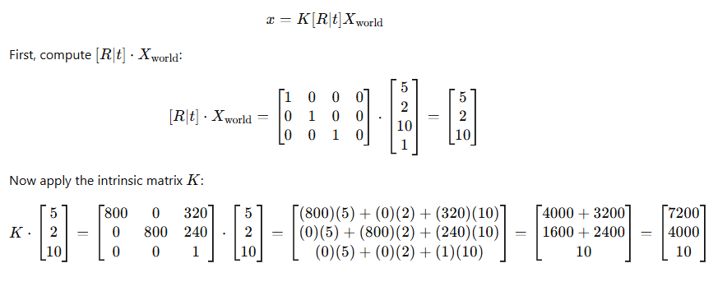
Converting 3D World Coordinates into 2D Image Coordinates

Slide 50
Converting 3D World Coordinates into 2D Image Coordinates
Final Step: Normalize to Get 2D Point
Divide by third component (homogeneous normalization):
𝑥=7200/10=720,𝑦=4000/10=400
Final Answer: The 3D point (5, 2, 10) projects to 2D image coordinate: (720, 400)

Slide 51
Assignments
Assignment#01 Marks 02
Task 01: Create pinhole camera physical model and bring it to next class.
Task 02: List, full form and describe the following image formats:
JPEG, JPG, PNG, GIF, BMP, TIFF, TIF, WEBP, HEIF, HEIC, PGM, SVG, AI, EPS, PDF
Deadline: Thursday 21st August 2025 11:00 pm
No extension of deadline!

Slide 52
Summary
Image plane consist of 2D plane
Perspective projection gives us realistic view of real-world in 2D
Image is like a function and various operations can be performed on it.
PinHole camera is the base for all cameras even today.
Camera intrisics and extrinics play a vital role in 3D reconstruction.

